Slide 1
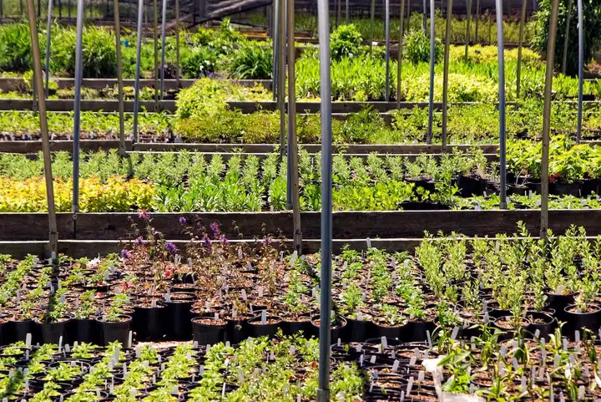

Slide 2
Nursery structures
Overview of Nursery Structures
Nursery structures are essential for the successful cultivation of seedlings, saplings, providing a favorable environment that promotes healthy and Uniform growth. These structures can vary significantly based on their design, materials, and intended use.
Types of Nursery Structures
Open Field Nurseries:
Established in open areas without permanent structures.
Commonly utilize flat, raised, or sunken seedbeds.
Vulnerable to environmental conditions such as wind and rain.
Protected Structures:
Designed to shield seedlings from harsh weather and pests.
Types include:
Thatched Roof: Offers basic protection from extreme weather.
Shade-Nets: Used to provide varying levels of shade depending on plant requirements.
Poly-tunnels: Covered with plastic to create a greenhouse effect, protecting plants from cold and wind.
Greenhouses/Poly-houses: More sophisticated structures that allow for temperature and humidity control, enhancing plant growth conditions

Slide 3
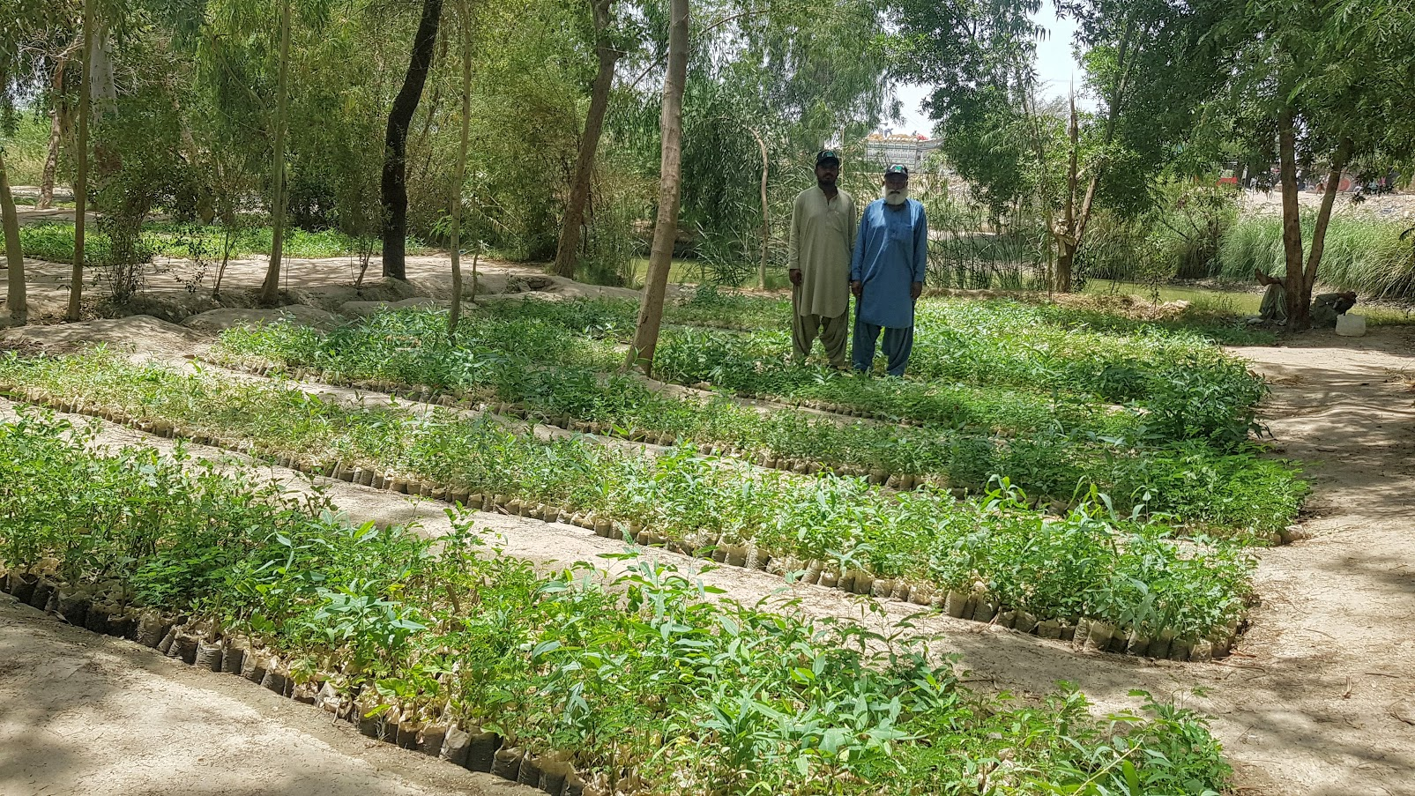
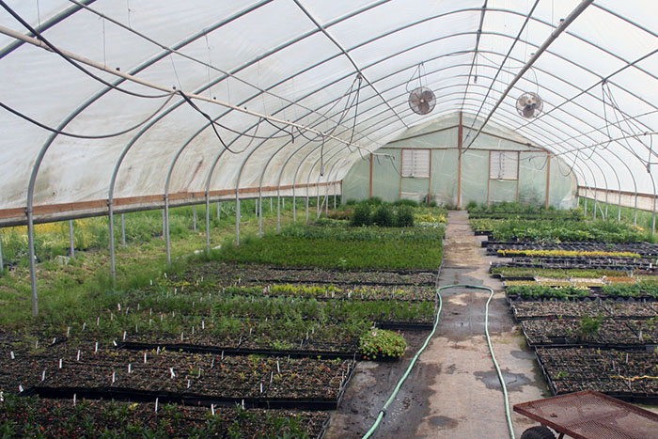
Open field Nursery
Control field Nursery

Slide 4
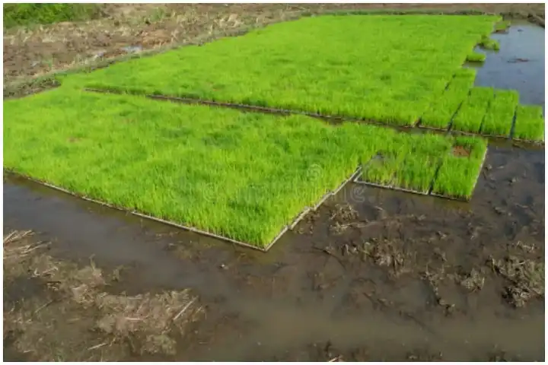
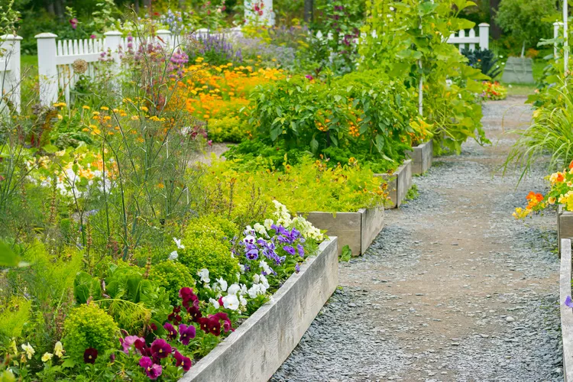
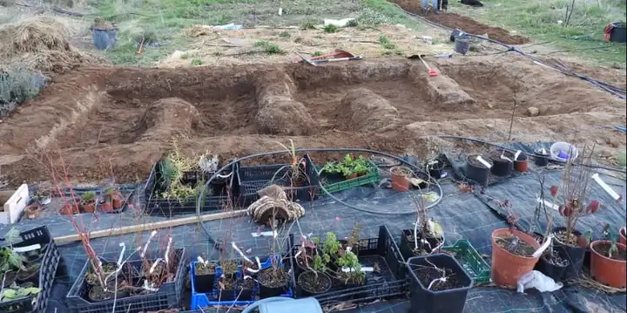
Raised Bed
Sunken Bed
Flat bed

Slide 5
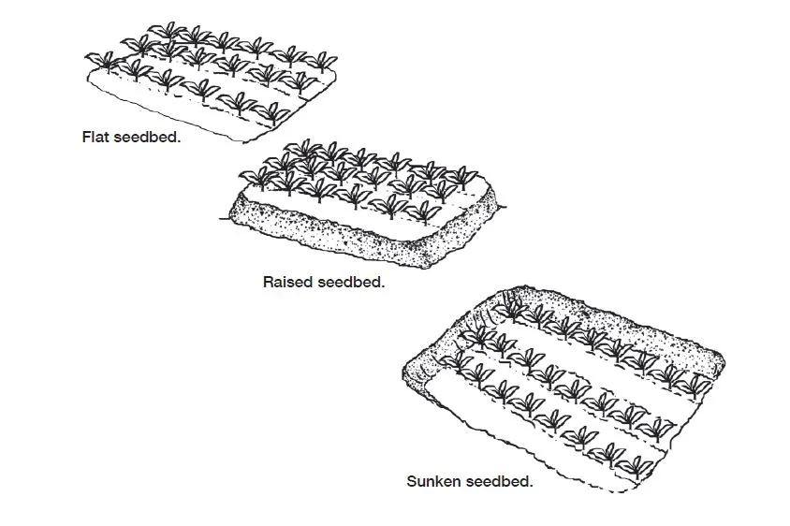
Bed Type | Height (cm) | Width (m) | Length (m)
Flat Bed | 0 | 1 - 1.5 | 3 - 5
Raised Bed | 15 | 1 - 1.5 | 3 - 5
Sunken Bed | 10 - 15 | ~1 | 3 - 5

Slide 6
Open field nursery Bed Types
There are three main types of nursery beds:
Flat Beds: Commonly used for sowing seeds directly into the soil. Flat beds are prepared at ground level and are ideal for areas with light sandy or sandy loam soil. Rice, Tomato, Cabbage, Brinjal etc
Raised Beds: Elevated structures that improve drainage and accessibility. Raised beds are elevated about 15 cm above the ground, making them suitable for moist areas where drainage is crucial. They help prevent waterlogging and improve soil aeration. Eg: Carrot, potato, peppers
Sunken Beds: Excavated areas that conserve moisture, particularly beneficial in dry regions sunken beds are prepared below ground level (10–15 cm). They conserve moisture and protect seedlings from harsh weather conditions. Eg: Lettuce, Spinich and Beet.

Slide 7
Hotbeds and cold frames are both structures used in gardening to extend the growing season and protect plants from adverse weather conditions. However, they differ primarily in their heating methods and applications.
Hotbeds
Heating Source: Hotbeds are equipped with a supplemental heating source. This can includes: Organic Material: Fresh manure (such as cow or horse manure) generates heat through decomposition.
Electric Heating Cables: These cables can be laid in the soil to provide consistent warmth.
Steam or Hot Water: Some hotbeds use steam pipes or hot water systems for heating.
Functionality: Hotbeds allow for earlier planting in spring and extended growing into fall and winter. They create a warmer environment that encourages quicker germination and growth of seedlings.
Construction: Typically built slightly below ground level or at ground level, hotbeds often have a glass or plastic cover to trap heat. They can be permanent structures made of wood, concrete, or brick.
Cold Frames
Heating Source: Cold frames do not have a supplemental heat source. Instead, they rely on passive solar heating: The structure captures sunlight, which warms the air inside.
Temperature moderation occurs naturally, providing a few degrees of protection against frost.
Functionality: Cold frames are ideal for hardening off seedlings before transplanting them outdoors. They can also be used to grow cold-tolerant crops during the early spring or late fall.
Construction: Cold frames are simpler in design, often made from wood or metal frames covered with glass or clear plastic. They can be built at ground level or slightly elevated but do not require heating systems.

Slide 8
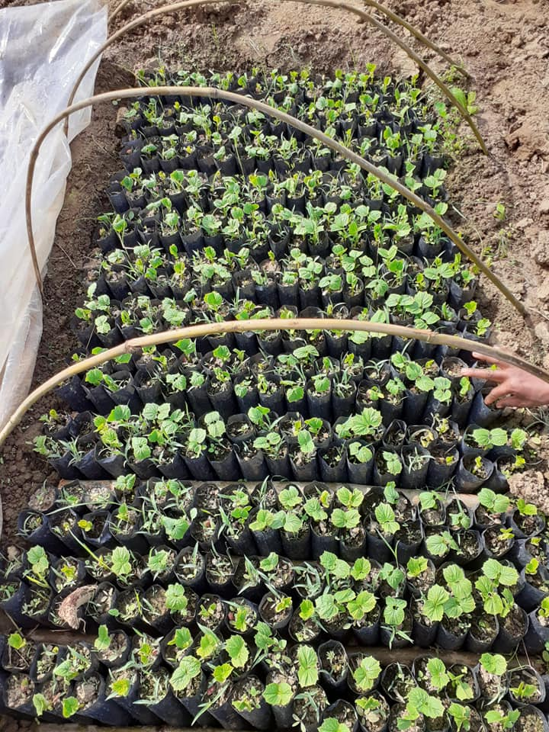
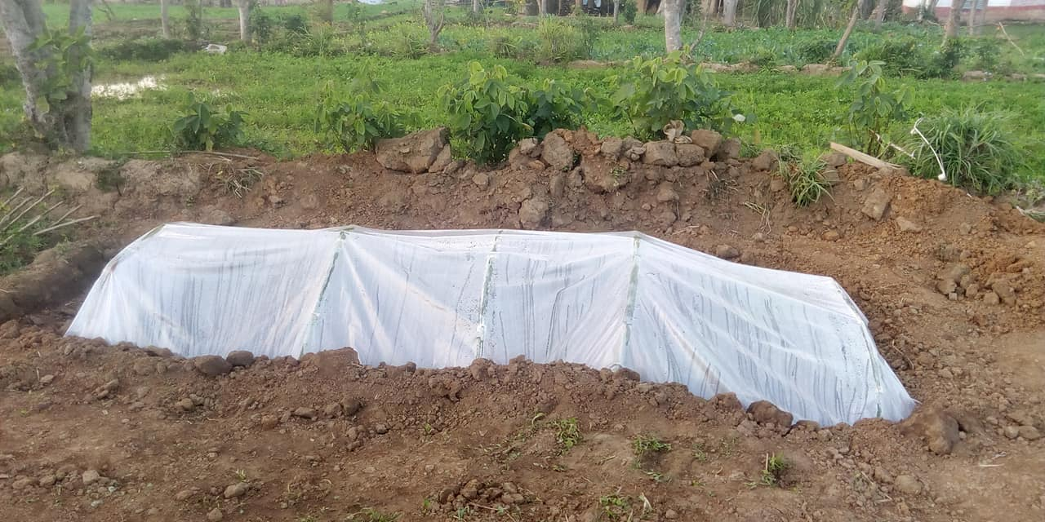
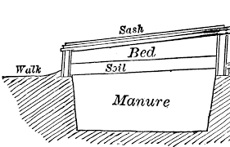

Slide 9
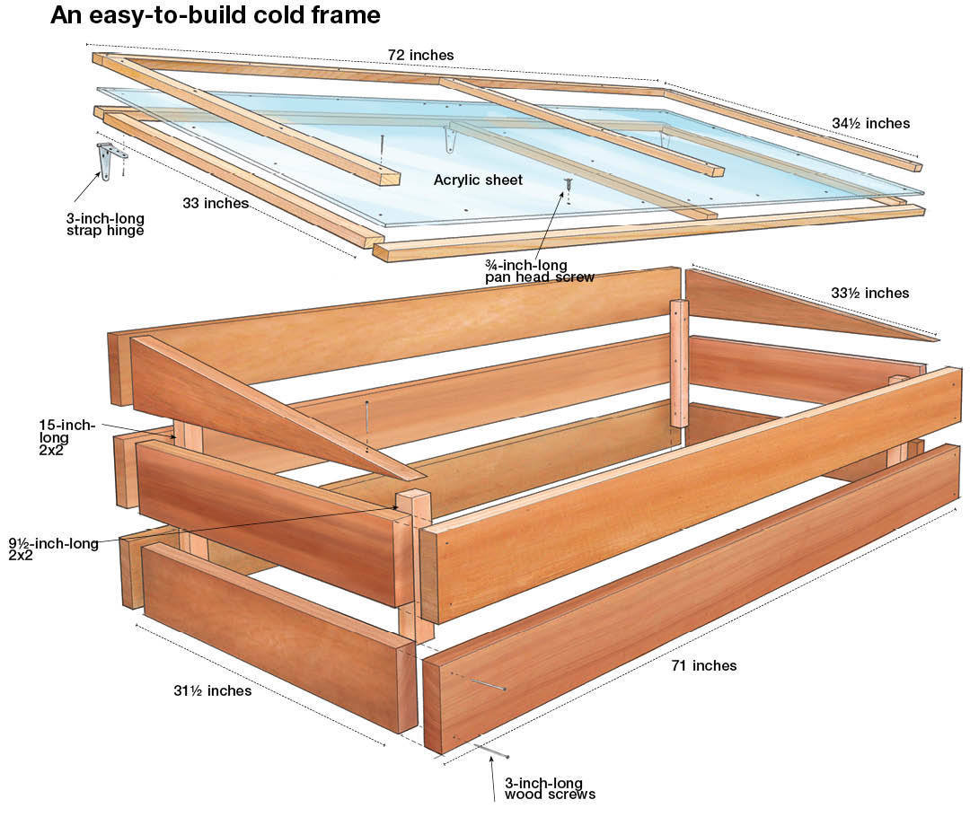
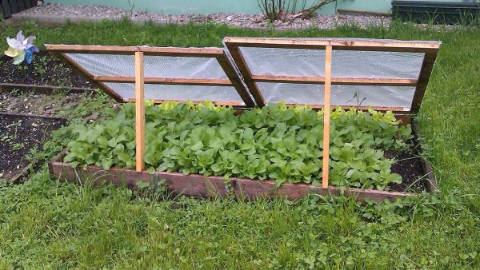

Slide 10
Features | Hot Beds | Cold Frames
Heating Source | Supplemental heat (manure, electric cables) | Solar energy only
Construction | Often deeper, more permanent | Simpler, can be moved easily
Usage | Early germination, faster growth | Hardening off seedlings
Temperature Control | Maintains higher temperatures | Relies on ambient temperatures
Season Extension | Extends growing season significantly | Provides moderate extension
Cost | Generally more expensive due to heating elements | Typically less expensive

Slide 11
Types of Tunnels in Agriculture
Tunnels are essential structures in agriculture that help create controlled environments for crop growth. Here’s a comparison of the main types of tunnels: low tunnels, walk-in tunnels, and high tunnels.
Type of Tunnel | Height | Structure Characteristics | Suitable Vegetables | Benefits
Low Tunnel/as caterpillar tunnels | ~1 meter | Made with arched hoops covered with fabric | Bitter gourd, sponge gourd, musk melon, watermelon | Protects crops from frost and harsh weather; easy to install and cost-effective.
Walk-in Tunnel | ~2-2.5 meters | Taller than low tunnels, allowing easy access | Sweet pepper, hot pepper, cucumber, vegetable marrow | Better sunlight and ventilation; suitable for a wider variety of crops; higher yields than low tunnels.
High Tunnel | ~4-5 meters | Larger structure with more robust materials | Cucumber, tomato, bottle gourd | Maximum yield potential; facilitates easier maintenance and crop management.

Slide 12
